Slide 1

AHA (Agile Hardware): Progress & Plans
Clark Barrett, Kayvon Fatahalian, Pat Hanrahan,
Mark Horowitz, Priyanka Raina
10/14/2018

Slide 2
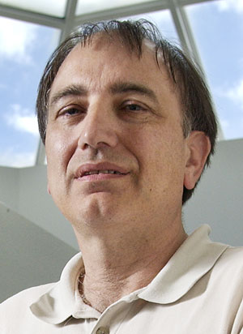



Team
Pat Hanrahan Clark Barrett Kayvon Fatahalian Priyanka Raina

Slide 3
The Semiconductor Business is Changing
Scaling is slowing
Chip design is very expensive
The industry is consolidating
Good VLSI designers are now all going to systems companies
The industry is re-integrating

Slide 4
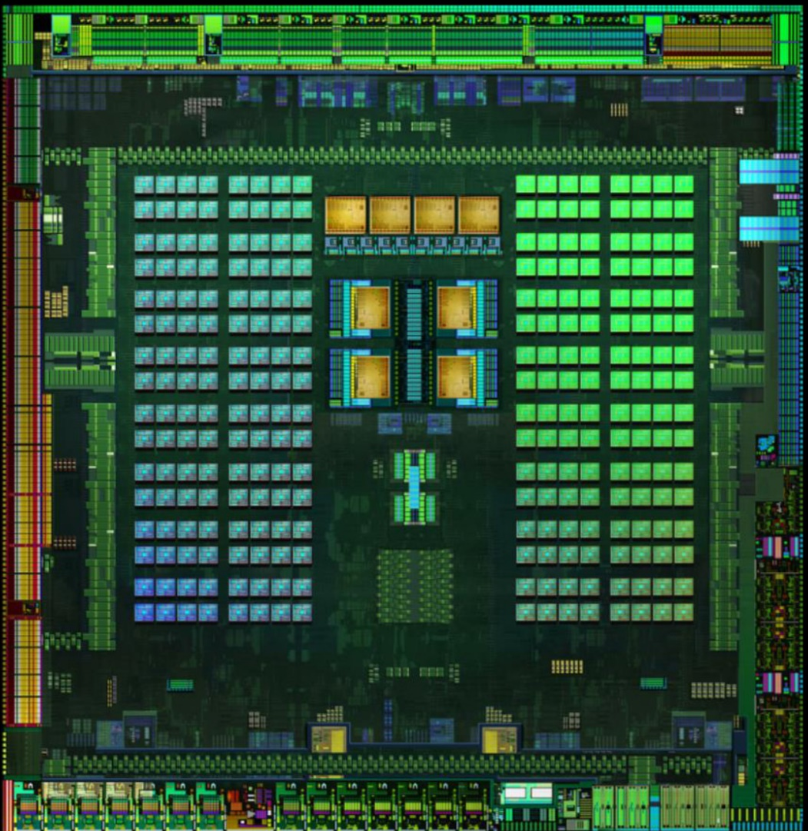
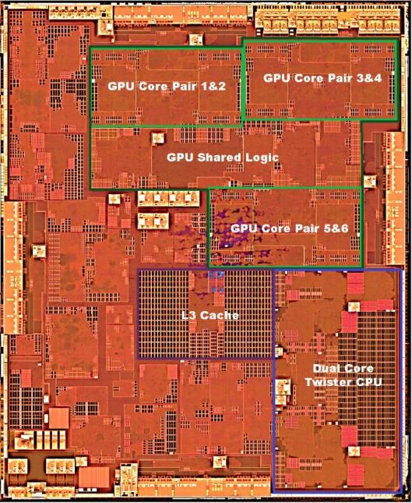
Specialized Hardware - DSSoC
Tegra X1
Apple A9

Slide 5
The New Challenge:
How to efficiently create these systems w/ accelerators
Which is much harder than producing the accelerator
Porting an application to hardware
Is about reframing the algorithm as much as hardware design
Need expertise in the application area and hardware design

Slide 6
AHA – Agile Hardware
It is partly a mindset, but it is more than that
Start with application
Quickly map to hardware
Repeat

Slide 7
Success Depends On Avoiding:
Specialized Hardware Mistake
Save Computing Mistake

Slide 8
The Specialized Hardware Mistake
Study the application
Build the hardware
Then write the software for the machine
And that is the only application this hardware will ever support…
Repeat

Slide 9

This Is The
Model of Design

Slide 10
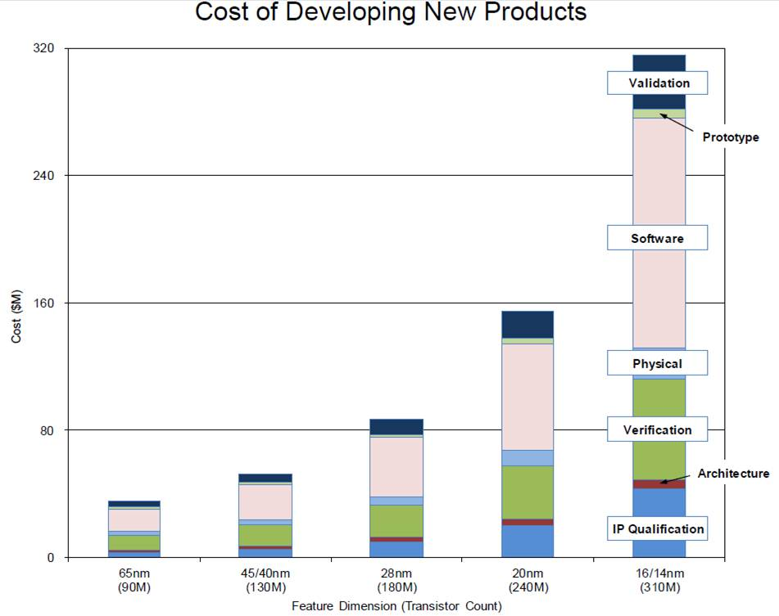
Doesn’t Address The Biggest Issue
Source: IBS
Notes:
To move to the next slide: So how do we deal with complexity? How have we historically dealt with it?

Slide 11
To Quickly Map App to Hardware
Application
Architecture
Need Some Isolation

Slide 12
The Abstract Hardware Model
(Avoiding the Save Computing Mistake)
Accelerators only work for local, compute intensive, applications
Everything else will be limited by the memory system
Our hardware IR should be good for these applications

Slide 13
Optimizing with an “ISA” An Agile Approach to Accelerators
Key idea:
Maintain end-to-end flow no matter what
Always be able to compile new applications
Incrementally change tools/fabric to improve performance
Accelerator becomes optimization of underlying fabric
Heterogeneous fabric, which may or may not need “new” instructions

Slide 14
To Quickly Map App to Hardware
Application needs to be written in a DSL (Visual Computing)
Halide
Compiler maps it to a programmable hardware model (ISA)
CoreIR
Map, place/route lowered application to target hardware
CGRA

Slide 15
Why Halide
Separates schedule from function
Already is an embedded language
Easy to indicate what should be accelerated
Generates good code for the rest

Slide 16
Why CoreIR
Formal semantics
Facilitates formal checking of design flow
Representation (DAGs of operations)
Matches the representation of our applications
Allows linking of inputs from other systems
It isn’t ego-centric

Slide 17
Why CGRA
It is universal
It can map any application
It is a spatial architecture
So we can make it look like any accelerator

Slide 18
Also Need To Build The Hardware Target
This is an SoC with a CGRA
Where the CGRA is continually being updated
These updates improve the “accelerator”
Need to create a generator to create this SoC

Slide 19
Progress and Plans
Application to coreIR
Halide compiler work, autoscheduling
CoreIR, and mapping coreIR to CGRA
CGRA design, generating CGRA
Test and validation environment

Slide 20
AHA Toolchain (working)
Image processing DSLs: e.g., Halide, DNN IRs
Magma/Chisel
Gensis2
Verilog
Dataflow / Tensor
autoscheduler
CoreIR (LLVM for HW)
SMT
Checking
Fast simulation SMT-based verification
Optimization/Analysis Passes Technology/Mapping
Place and Route
Halide backend
FPGA
ASIC
Stanford CGRA
Generator
Host code

Slide 21
Halide to CoreIR
Newly implemented codegen capabilities
ROM generation
multi-dimensional linebuffers
valid bit generation from linebuffers
Generating hardware from more applications
Unit tests: logical right shift, counter, …
Full apps: demosaic, optical flow, camera pipeline, …

Slide 22
Halide to CoreIR Plans
Currently rebasing to top-of-tree
First application complete: 3x3 convolution with updated compiler
Re-expressing scheduling primitives
Hardware accelerator tiling based on GPU tiling
Primitives for linebuffer and full pipeline throughput
Merge DNN and image hardware branches to top-of-tree

Slide 23
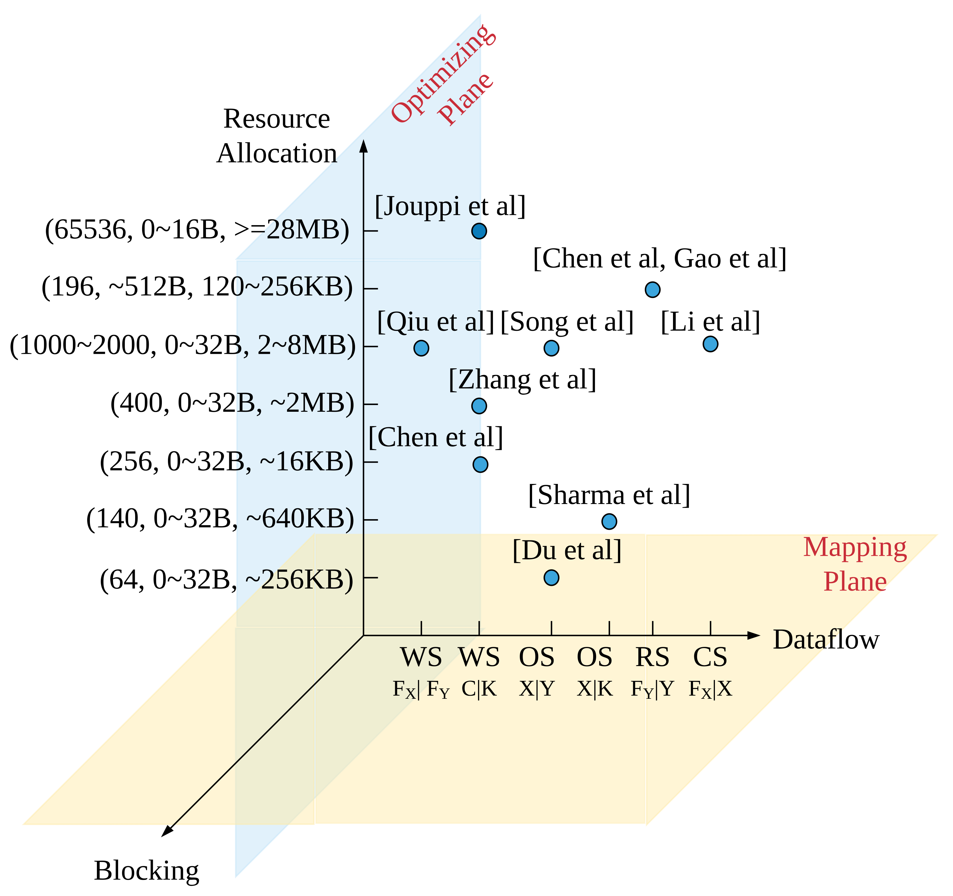
Halide Auto-schedulers
Auto-schedulers
Both for Halide and for Halide like IR (joint work with Google)
Complete scheduler for DNNs
Can use any existing hardware

Slide 24
Auto-scheduler Plans
Continue work on g.p. Halide scheduler
Joint work with Andrew Adams, Facebook
Create auto-scheduler for joint hardware generation
Streaming and blocking computations

Slide 25
Addressing the Hard Problem:
No one wants hardware for this application
They want hardware for this type of application
How to create the hardware they want?
CGRA might be a solution
Look at creating generalize functions
Explore different implementation options

Slide 26
CoreIR to CGRA
Basic system is up and running
Can read inputs from Verilog, FIRRTL, Rigel, Halide, Magma
Formal semantics
Primitives have equivalent to SMT bit vectors
Created new P&R flow
It is in use in current flow
Extensible framework
Easy to add passes or extentions to the system

Slide 27
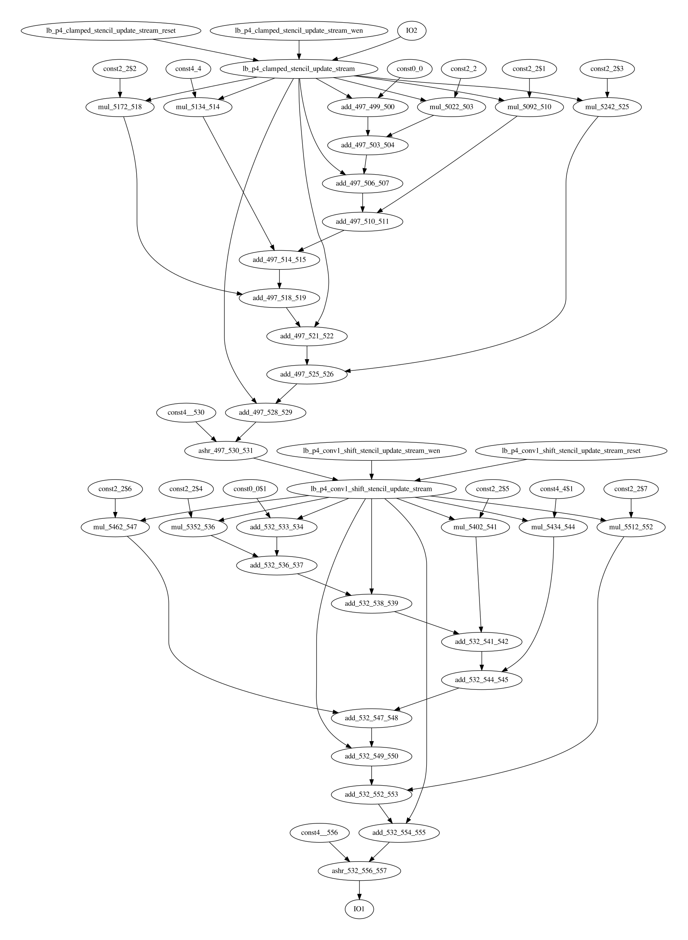
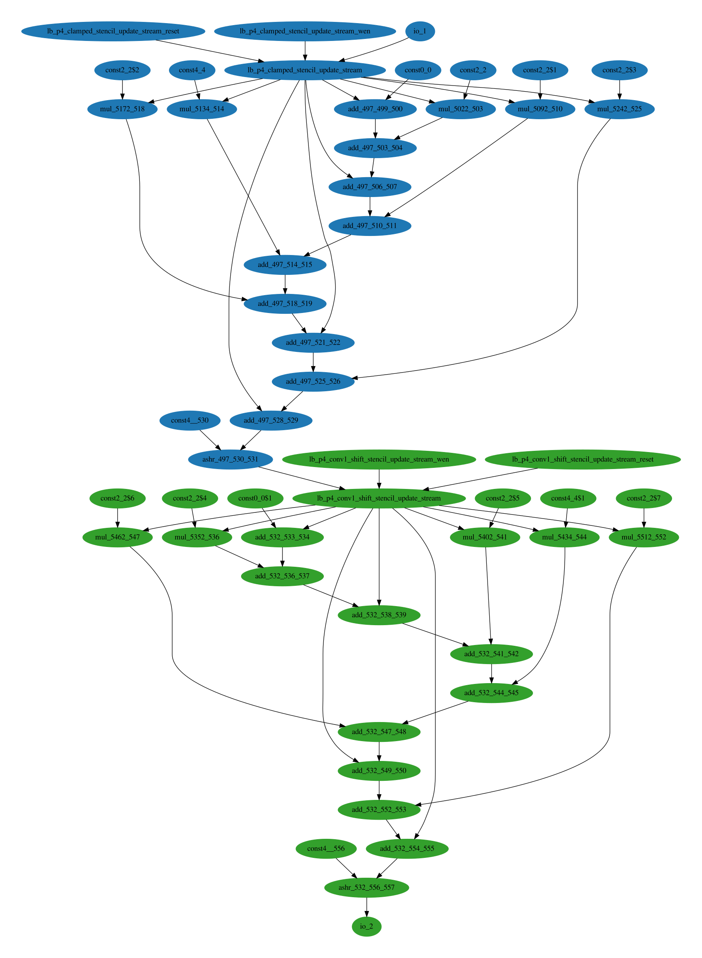
Kernel Discovery from Dataflow Graph
Two convolutions
Two kernels
Cascade Example

Slide 28
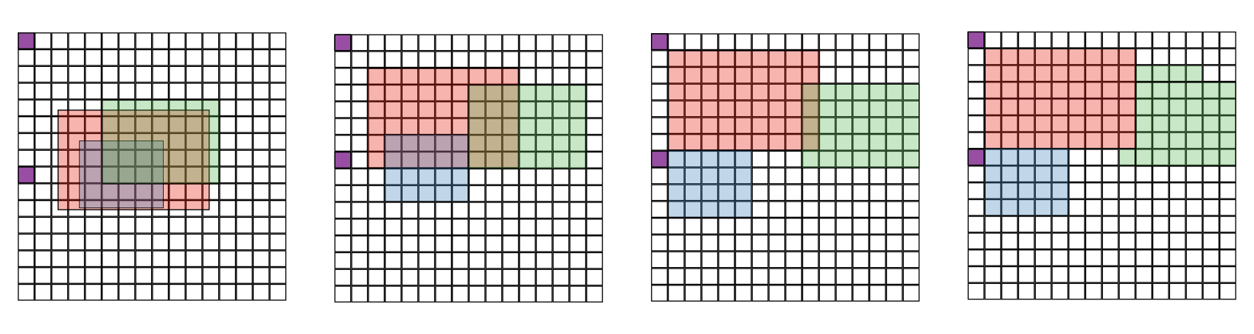
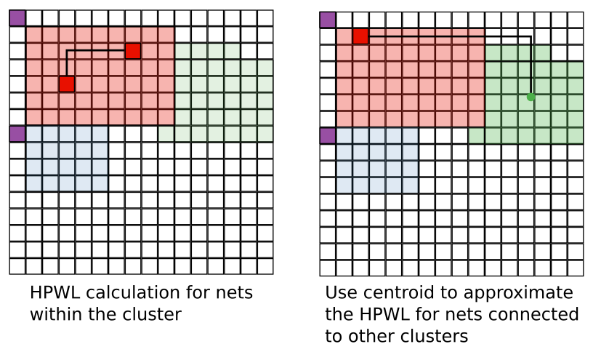
Placement Details
Force-Directed Global Placement
Simulated Annealing Detailed Placement

Slide 29
CoreIR to CGRA Plans
Extend coreIR feature set to enable wider set of applications
More operand types (e.g. floating point)
More operators (div, generalized exponentials)
Extended coreIR and P&R analysis passes:
Register retiming
Improved mapping/packing pass for CGRA
Suggest changes to CGRA design to improve efficiency

Slide 30
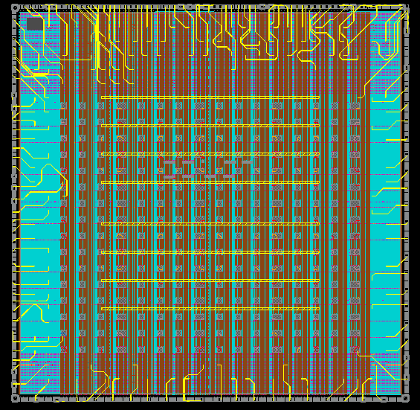
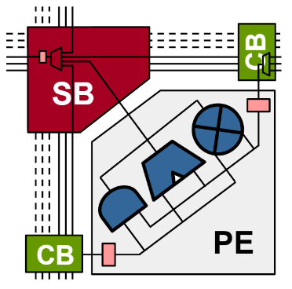
Taped Out Our First CGRA

Slide 31
CGRA Plans
Fix problems with current system to make it easily buildable
Create virtual tape-out flow
Increase capability of the FU
Bfloat16 data types, divide, transcendental support
Memory hierarchies
Fast reconfiguration, testing and debug support
Explore supporting dynamic launch, as used in modem processing

Slide 32
Next-Gen CGRA Generator
See next talk

Slide 33
Using Just-In-Time Compilation to Accelerate CGRA Simulations
Problem: Statically programmable datapaths are slow in conventional hardware simulators
Solution: just in time (JIT) compilation

Slide 34
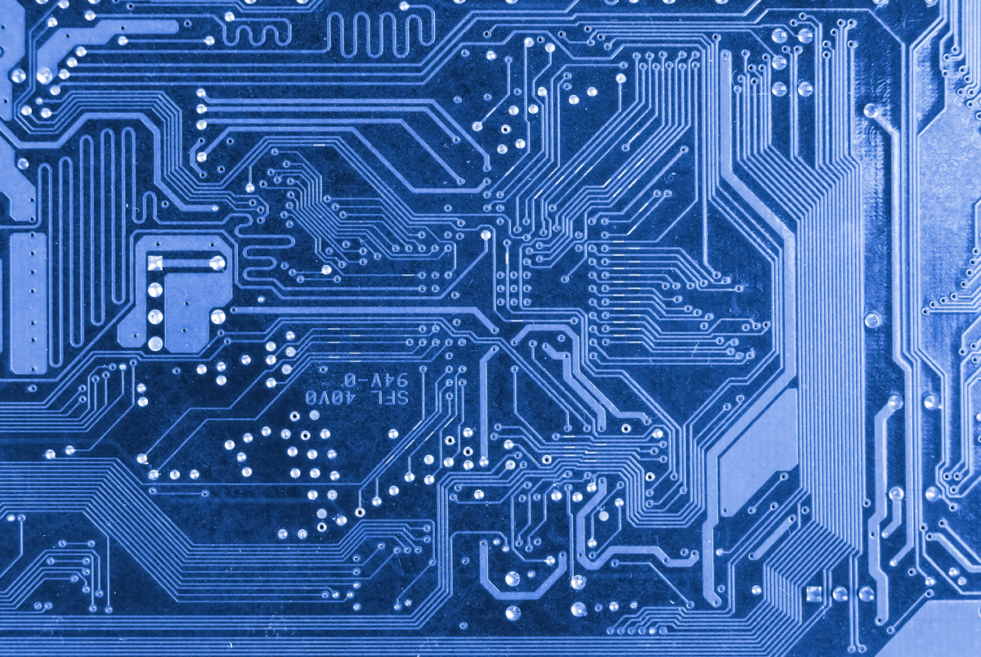



CoSA: CoreIR Symbolic Analyzer
No
+
Expected Behavior
System Design
clk
en
out
Yes
CoSA is an SMT-based symbolic model checker for hardware design
Open-source, and written in Python
Supports multiple input formats including: CoreIR, Verilog, and SystemVerilog
Provide state-of-the-art formal analyses, including: Linear Temporal Logic (LTL) and invariant verification, equivalence checking, proving capabilities, fault analysis, and more…

Slide 35
Testing and Validation
See last talk

Slide 36
We Have a Complete System, But the Journey is Just Beginning
Thanks for helping with this project
It is great to be part of the next revolution in VLSI design

